Slide 1

Geometry
Unit 8, Lesson 4 Kites and Parallelograms Volume 2, pg. 25

Slide 2


Benchmark
MA.912.GR.1.4
Prove relationships and theorems about parallelograms. Solve mathematical and real-world problems involving postulates, relationships, and theorems of parallelograms.
volume 2, pg. 25

Slide 3
Integrated Mathematical Thinking and Reasoning Standards
MA.K12.MTR.1.1 Actively participate in effortful learning both individually and collectively.
MA.K12.MTR.2.1 Demonstrate understanding by representing problems in multiple ways.
MA.K12.MTR.4.1 Engage in discussions that reflect on the mathematical thinking of self and others.
MA.K12.MTR.5.1 Use patterns and structure to help understand and connect mathematical concepts.
MA.K12.MTR.7.1 Apply mathematics to real-world contexts.
volume 2, pg. 25

Slide 4

Learning Target
I can use properties of parallelograms, kites, and special parallelograms to solve mathematical and real‑world problems.
volume 2, pg. 25

Slide 5

Warm-Up
volume 2, pg. 26

Slide 6
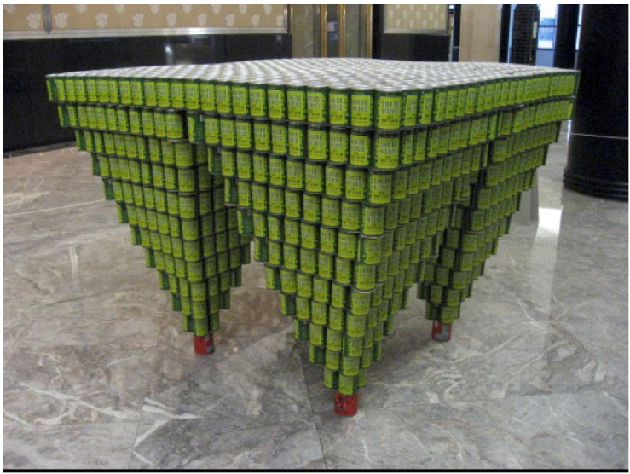
8.4.1 Warm-Up: Canstruction
Each year just before Thanksgiving there are competitions held all over the world to build unique Canstructions with canned food that is collected from the community. The food is then given to local food banks. The picture shows the Canstruction called "Downside Up," which was the winning exhibit from Canstruction 2010 in New York City.
volume 2, pg. 26

Slide 7
What do you wonder about “Downside Up”?
Make an educated guess at the number of cans used to build “Downside Up”. Show your work.
Compare your educated guess with your partner’s. Describe how close your guess was to your partner’s guess.
volume 2, pg. 26

Slide 8

Exploration
volume 2, pg. 26

Slide 9

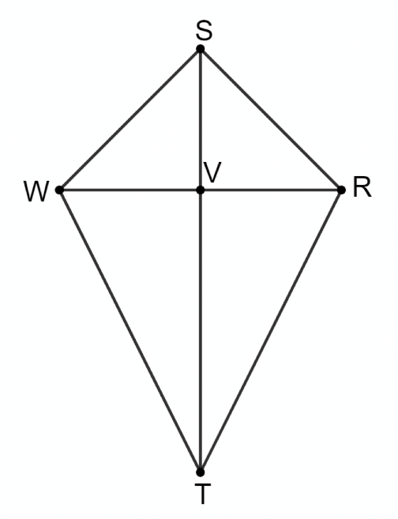
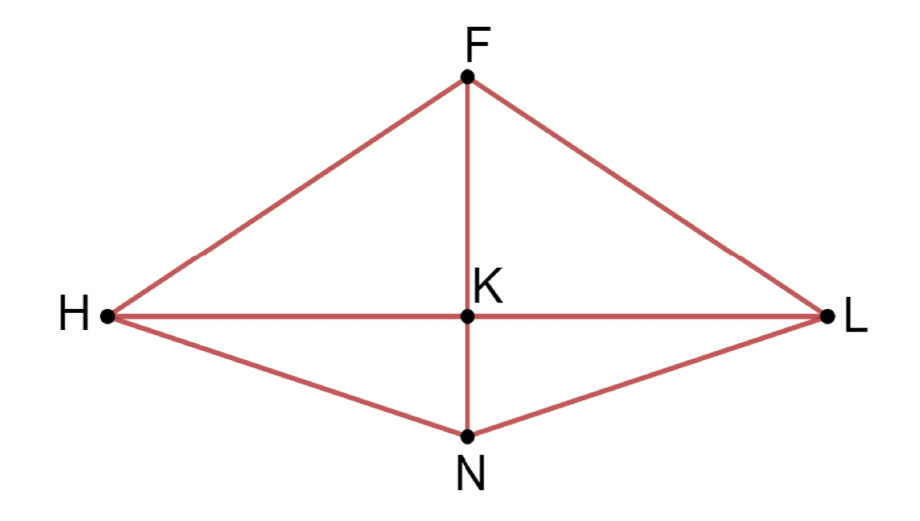
8.4.2 Exploration: What Is a Kite?
Kite $SRTW$ with diagonals $\overline{ST}$ and $\overline{WR}$ intersecting at point $V$ and $FLNH$ with diagonals $\overline{FN}$ and $\overline{HL}$ intersecting at point $K$ are shown.
volume 2, pg. 26

Slide 10
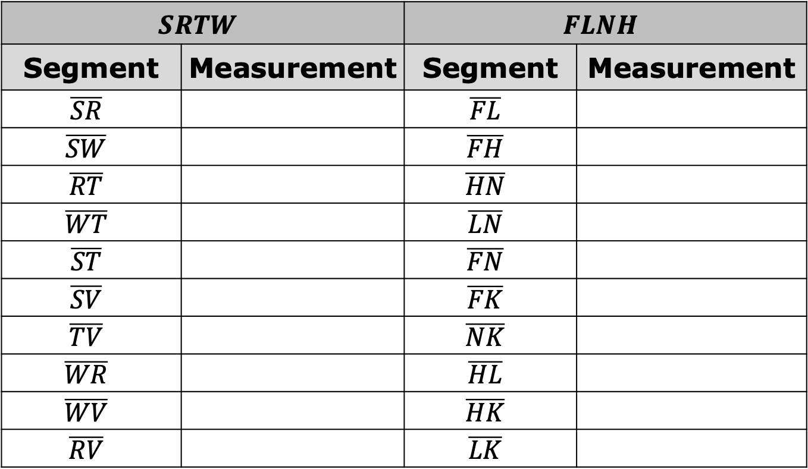
Using a ruler, work with a partner to fill in the chart below with the appropriate measurements. Each partner should find the measurements for one kite and share their results with the other.
$$SRTW$$ |  | $$FLNH$$
Segment | Measurement | Segment | Measurement
$$\overline{SR}$$ |  | $$\overline{FL}$$
$$\overline{SW}$$ |  | $$\overline{FH}$$
$$\overline{RT}$$ |  | $$\overline{HN}$$
$$\overline{WT}$$ |  | $$\overline{LN}$$
$$\overline{ST}$$ |  | $$\overline{FN}$$
$$\overline{SV}$$ |  | $$\overline{FK}$$
$$\overline{TV}$$ |  | $$\overline{NK}$$
$$\overline{WR}$$ |  | $$\overline{HL}$$
$$\overline{WV}$$ |  | $$\overline{HK}$$
$$\overline{RV}$$ |  | $$\overline{LK}$$
volume 2, pg. 27

Slide 11
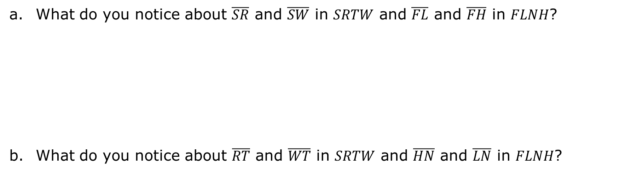
What do you notice about $\overline{SR}$ and $\overline{SW}$ in $SRTW$ and $\overline{FL}$ and $\overline{FH}$ in $FLNH$?
What do you notice about $\overline{RT}$ and $\overline{WT}$ in $SRTW$ and $\overline{HN}$ and $\overline{LN}$ in $FLNH$?
volume 2, pg. 27

Slide 12
These segment pairs are adjacent sides of a kite.
Make a conjecture about the measures of adjacent sides of a kite.
Make a conjecture about the lengths of diagonals of a kite.
volume 2, pg. 27

Slide 13
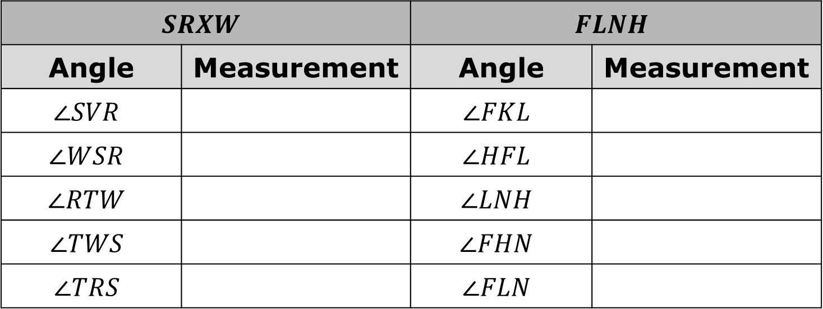
Using a protractor, work with your partner to fill in the chart below with the appropriate measurements. Each partner should find the measurements for one kite and share their results with the other.
$$SRXW$$ |  | $$FLNH$$
Angle | Measurement | Angle | Measurement
$$∠SVR$$ |  | $$∠FKL$$
$$∠WSR$$ |  | $$∠HFL$$
$$∠RTW$$ |  | $$∠LNH$$
$$∠TWS$$ |  | $$∠FHN$$
$$∠TRS$$ |  | $$∠FLN$$
volume 2, pg. 27

Slide 14
Make a conjecture about what happens when the diagonals of a kite intersect.
Make a conjecture about the measures of opposite angles of a kite.
volume 2, pg. 27

Slide 15

A kite is a quadrilateral with exactly two pairs of adjacent congruent sides.
A kite has the following properties:
One pair of opposite congruent angles
Perpendicular diagonals
One bisected diagonal
volume 2, pg. 28

Slide 16

Collaboration
volume 2, pg. 28

Slide 17

8.4.3 Collaboration: Quadrilaterals
With your partner, use the bank of phrases to fill in the chart comparing quadrilaterals. Statements can be used more than once.
Opposite sides are congruent. | Opposite sides are parallel.
All sides are congruent. | Diagonals bisect each other.
Opposite angles are congruent. | Diagonals are congruent.
All angles are congruent. | Diagonals are perpendicular.
volume 2, pg. 28

Slide 18
Two pairs of adjacent sides are congruent. | One diagonal is bisected.
One pair of opposite angles are congruent. | Opposite angles are supplementary.
One pair of parallel sides | Non-parallel sides are congruent.
Two pairs of congruent angles
volume 2, pg. 28

Slide 19
Write the letter(s) from the bank.
Quadrilateral | Sides | Angles | Diagonals
Parallelogram
Rectangle
Square
Rhombus
Kite
volume 2, pg. 28

Slide 20
Compare your chart with that of another pair. Add in anything you may have missed.
Discuss with your partner whether or not kites can be classified as parallelograms.
volume 2, pg. 29

Slide 21

Guided Instruction
volume 2, pg. 29

Slide 22
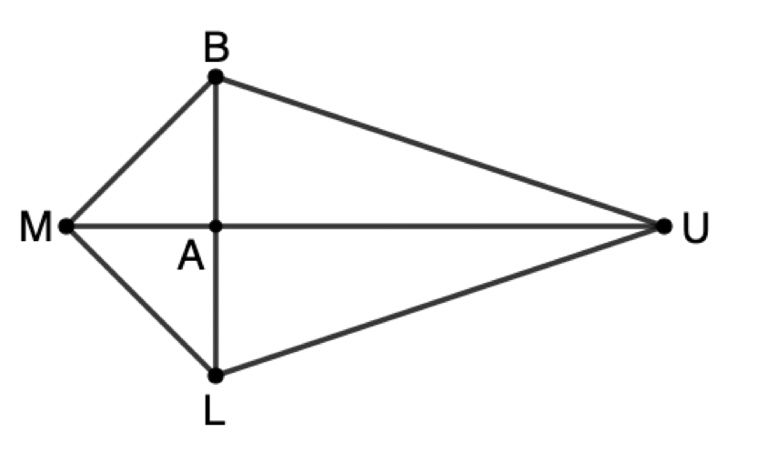
8.4.4 Guided Instruction: Quadrilaterals and Algebra
$MBUL$ with diagonals $\overline{BL}$ and $\overline{MU}$ intersecting at point $A$ is shown. Find the value of $x$ that makes $MBUL$ a kite if $BA=3x−1, LA=17, MA=2x, and UA=23.$
volume 2, pg. 29

Slide 23
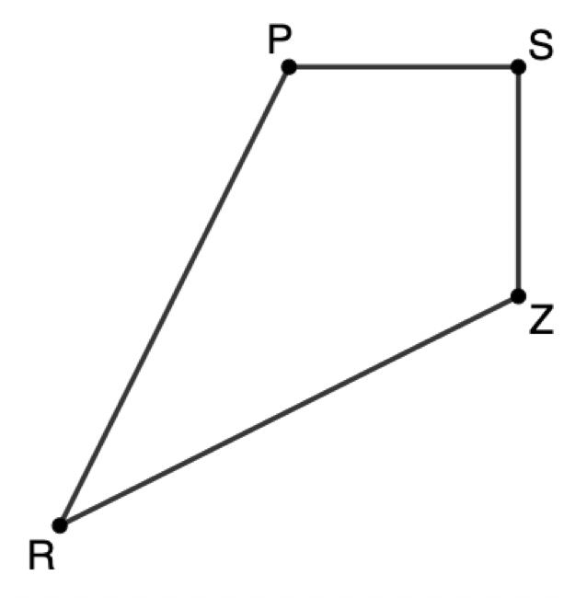
Find the values of $x$ and $y$ that make $PSZR$ a kite if $PS=5x−4$, $PR=8y−4$, $SZ=3y+1$, and $RZ=36$.
volume 2, pg. 30

Slide 24
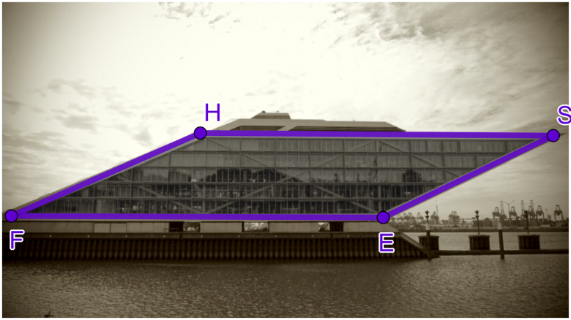

The Dockland office building is one of the most famous buildings in Hamburg, Germany. Built in 2005, this building houses roughly $9,000$ square meters of office space and breathtaking views of the Elbe River, but the size and the views are not what makes this building so famous. The building itself is in the shape of a parallelogram, $HSEF$.
The perimeter of the Dockland building measures approximately $238$ meters. If the length of $\overline{FE}$ is $2.8$ times the length of $\overline{FH}$, what are the measures of $\overline{HS}$, $\overline{SE}$, $\overline{FE}$, and $\overline{FH}$? Round your answers to the nearest thousandth of a meter.
volume 2, pg. 30

Slide 25

Your Turn
volume 2, pg. 31

Slide 26
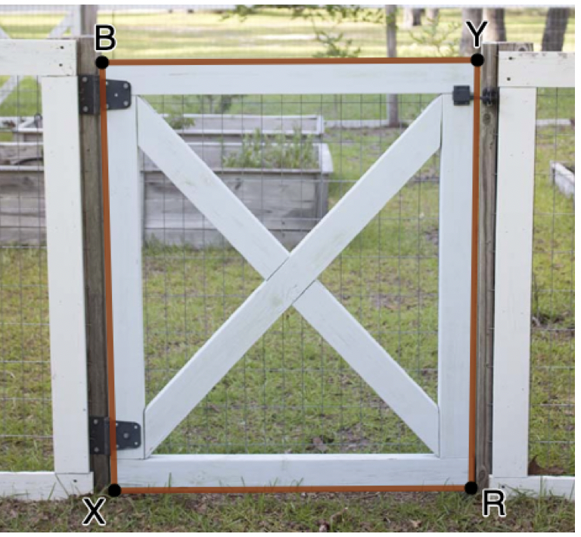
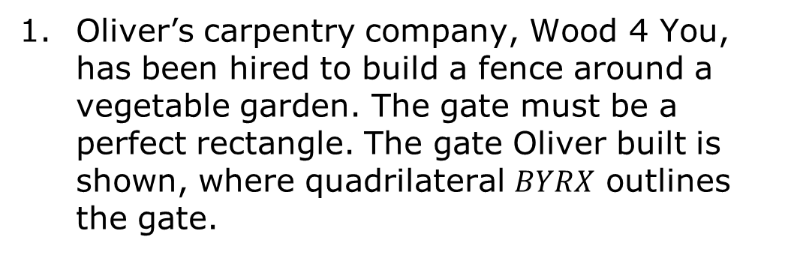
8.4.5 Your Turn!
Oliver’s carpentry company, Wood 4 You, has been hired to build a fence around a vegetable garden. The gate must be a perfect rectangle. The gate Oliver built is shown, where quadrilateral $BYRX$ outlines the gate.
Oliver wants to be absolutely sure that the gate is a rectangle. Describe two different ways Oliver can use his tape measure to ensure the gate is a true rectangle.
volume 2, pg. 31

Slide 27
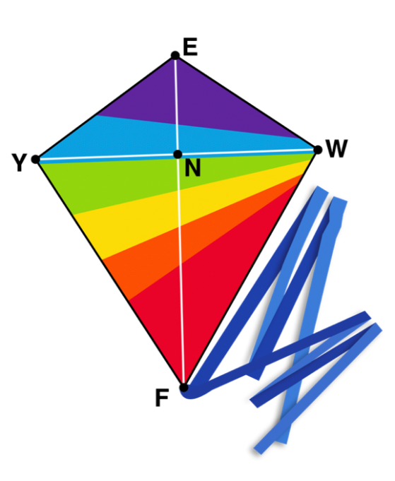
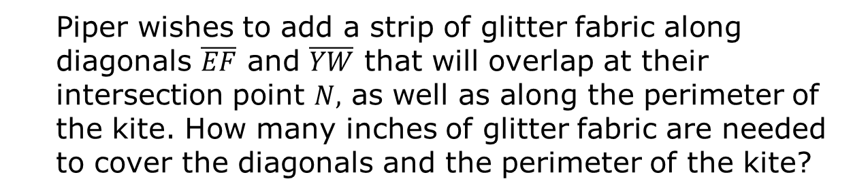
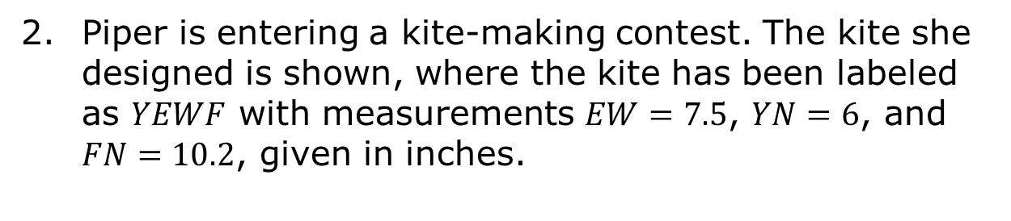
Piper is entering a kite-making contest. The kite she designed is shown, where the kite has been labeled as $YEWF$ with measurements $EW=7.5$, $YN=6$, and $FN=10.2$, given in inches.
Piper wishes to add a strip of glitter fabric along diagonals $\overline{EF}$ and $\overline{YW}$ that will overlap at their intersection point $N,$ as well as along the perimeter of the kite. How many inches of glitter fabric are needed to cover the diagonals and the perimeter of the kite?
volume 2, pg. 31

Slide 28

Wrap-Up
volume 2, pg. 32

Slide 29
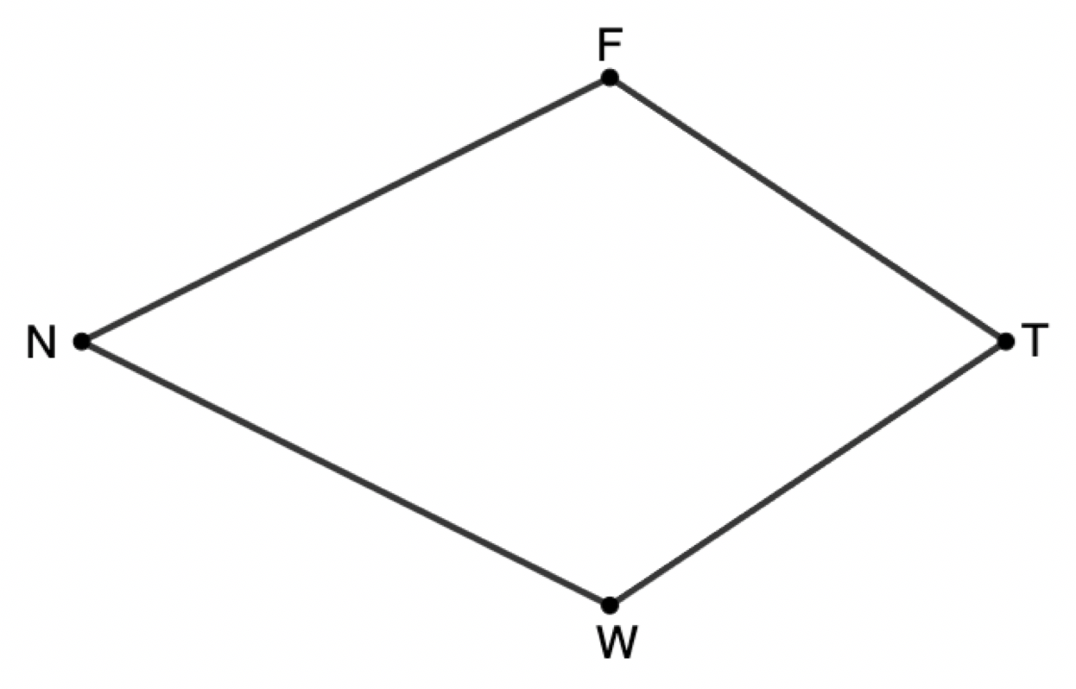
8.4.6 Wrap-Up: Cool Down
Kite $FTWN$ is shown. Find the value of $x$ if $m∠N=53°$, $m∠T=67°$, and $m∠F=\left(\frac{1}{2}x−8\right)°$.
volume 2, pg. 32

